Slide 1


Predictive Churn Tool Telecom Operator
Final Presentation
Notes:
Good afternoon everyone. Thank you for being here today.
We are thrilled to present the culmination of our work in analysing and predicting customer churn within your telco industry.

Slide 2
Agenda
Recap the initial problem or challenge.
Discuss why this problem was important to address and how it aligns with the client's goals.
01 Introduction
02 Methodology
03 Findings
04 Recommendations
Introduction 1 min
The Problem 1 min
Our approach 3 min
Solution Proposal 5 min
Appendix available
Describe the overall methodology used to approach the problem.
Highlight key data sources, tools, and techniques employed.
Emphasize any challenges faced and how they were overcome.
Notes:
We have an exciting agenda ahead, and we appreciate your time and participation with any question you might have at the end.
We’ll kick-off with an intro, then briefly explaining the methodology along the presentation. We’ll also present key findings and final recommendations.
We have an appendix at the end of the presentation which you can consult afterwards with detail on some sections.

Slide 3

Project status
Today
September
October
November
December
Activity
1
2
3
4
1
2
3
4
1
2
3
4
5
1
2
Today marks the presentation of final conclusions
Planning & Assessment
Project scope definition and workspace set-up
Business understanding
Exploratory data analysis and preprocessing
Feature engineering and clustering analysis
Predict Churn & Define Action Plan
Identify best performing model
Define strategies
Final presentation
Key collaborative moments
Notes:
In terms of status, we have reached the end of our work together during the last 3 months. And today marks the final presentation of our conclusions.

Slide 4
Executive Summary
Situation
Actions
Results Achieved
Client
US-based telecom operator
Challenge
A need to understand customers’ profiles
Is losing an amount of valuable customers
Objectives
Build a tool identifying potential high-risk churners
Implement proactive initiatives to win-back high-risk customers and increase stickiness
How our team helped
Developed exploratory analysis of customers base and churners
Clustering customers based on their different characteristics and behaviours
Developed tailored, and fine-tuned predictive algorithms for churning
Designed proactive retention actions to address specific pain points and stickiness initiatives for low churn correlations
Presented a full overview, and characterization of the company’s customer base
Identified 3 unique customer segments, identified key characteristics of each, and their churning inclination
Delivered predictive models trained on past churners to identify future potential churners
Recommended 15 specific action items grouped in 5 areas with discriminate levels of priority to decrease the company’s churn
Notes:
Here’s the Executive Summary.
In light of the current situation, our team conducted a thorough analysis, identifying 15 opportunities that can decrease the company’s churn.
1min

Slide 5
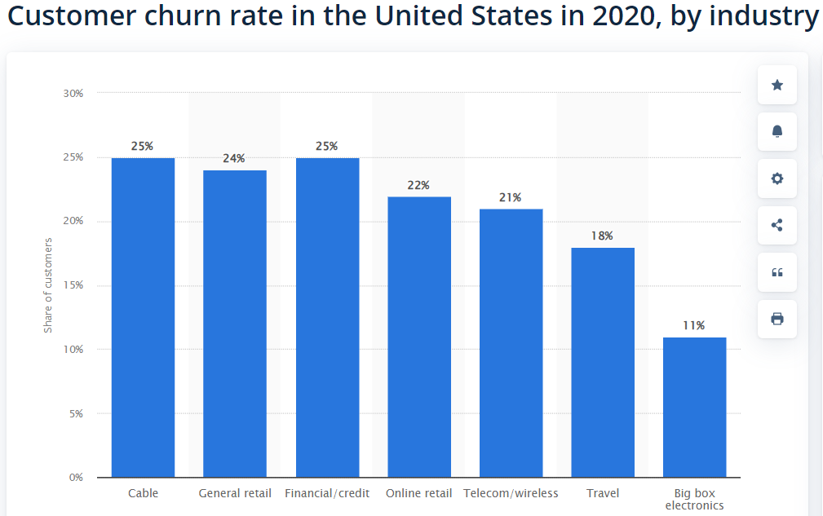
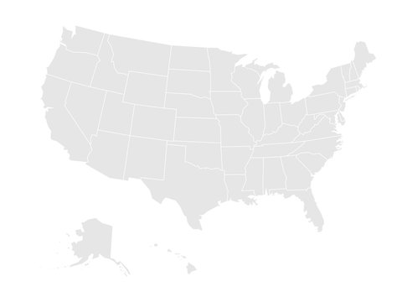
Introduction
Methodology
Findings
Recommendations
“
The current problem: Why Churn matters?
Telcos are losing customers & sales, and are spending money on marketing campaigns aimed at the wrong audiences
Telcos will be able to target potential churner to retain them
Average Churn Rate For Telco Industry¹
21%
Telcos would like to increase customer retention
An explanation to churn is needed
Notes:
But why churn matters? Telcos are losing customers & sales.
We recognize the significance of retaining customers in the competitive landscape of telecommunications and finding explanations for churn.
By doing this, telcos will be able to target potential churners to retain them.
The average churn rate is 21% in the US, so our client is above this which is becoming critical.

Slide 6





Introduction
Methodology
Findings
Recommendations
US-based telecom operator, with +7k customers, a total revenue of $21 m and a 27% churn rate which causes a loss of ~$ 2m per month
Telco Overview
Services
Brief description
7043
Customers
Revenue
$ 21.4 million Total
$ 3034 per Customer
Phone
Internet (DSL, Fiber Optic and Cable)
Add-ons (Online security service, backup, device protection, support)
Streaming
Billing and payment options
A US-based telecom operator that offers communication solutions to its customers.
Uses IBM SPSS Modeler to predict a churn score, satisfaction and CLTV.
7043
Clients
Revenue
$ 21.4 million Total
$ 3034 per Customer
California,
USA
3.2 Satisfaction Score (Avg. out of 5)
46% Refferal rate
2.7 years Tenure
Services
Losing $ 2m / month
Phone
Internet (DSL, Fiber Optic and Cable)
Add-ons (Online security service, backup, device protection, support)
Streaming
Billing and payment options
3.2 Satisfaction Score (Avg. out of 5)
46% Refferal rate
2.7 years Tenure
Notes:
Out of your base of 7k customers, you are losing 27% of them which causes a loss of $ 2m per month.

Slide 7

Introduction
Methodology
Findings
Recommendations
We will deep-dive on Customers’ understanding and Churners’ characterisation
Telco Overview
Services
Brief description
7043
Customers
Revenue
$ 21.4 million Total
$ 3034 per Customer
Phone
Internet (DSL, Fiber Optic and Cable)
Add-ons (Online security service, backup, device protection, support)
Streaming
Billing and payment options
A US-based telecom operator that offers communication solutions to its customers.
Uses IBM SPSS Modeler to predict a churn score, satisfaction and CLTV.
7043
Clients
Revenue
$ 21.4 million Total
$ 3034 per Customer
California,
USA
3.2 Satisfaction Score (Avg. out of 5)
46% Refferal rate
2.7 years Tenure
Services
Losing $ 2m / month
Phone
Internet (DSL, Fiber Optic and Cable)
Add-ons (Online security service, backup, device protection, support)
Streaming
Billing and payment options
3.2 Satisfaction Score (Avg. out of 5)
46% Refferal rate
2.7 years Tenure

Slide 8

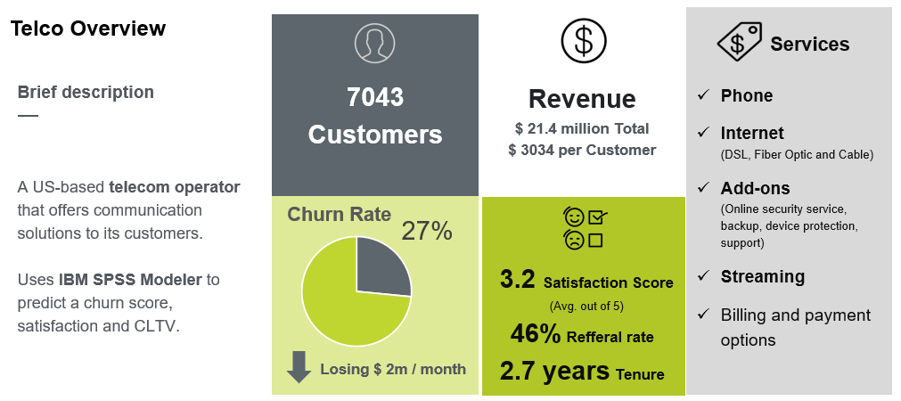
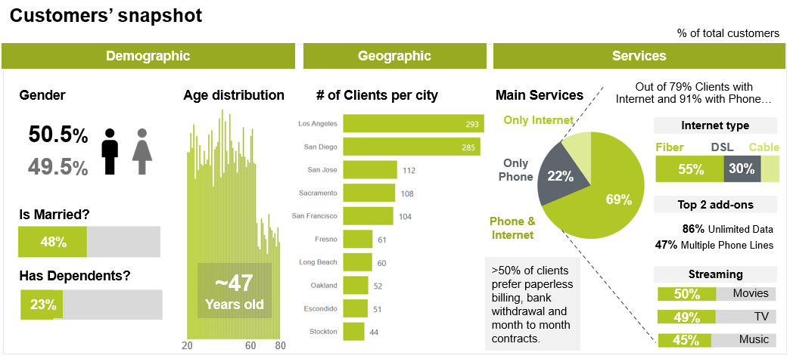
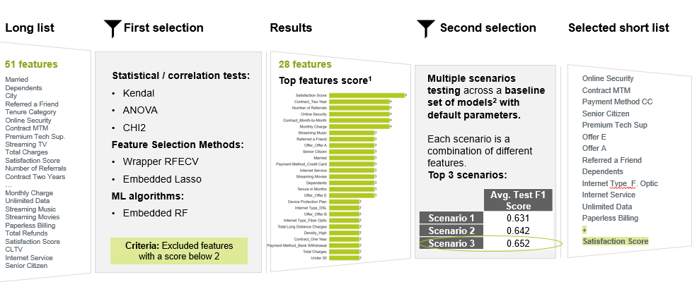
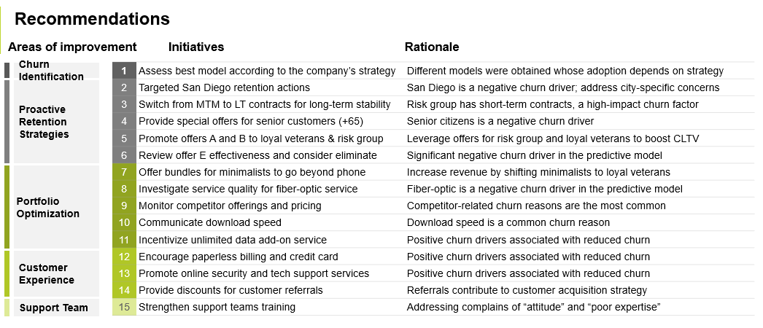
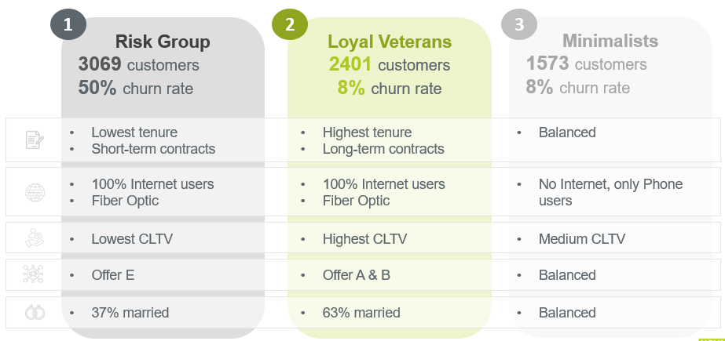
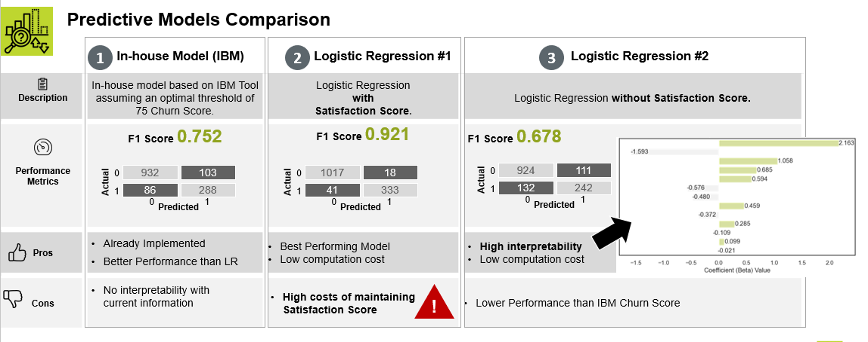
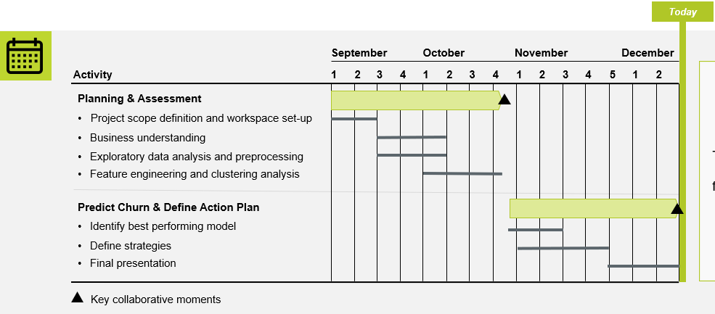
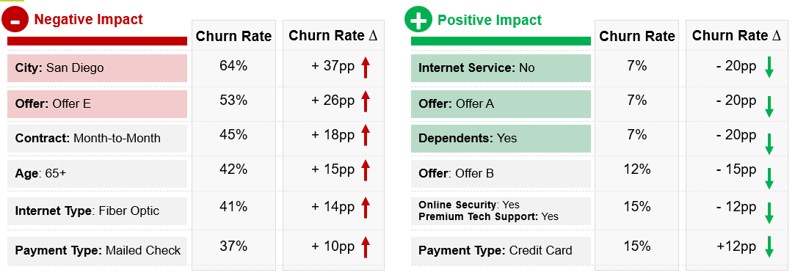
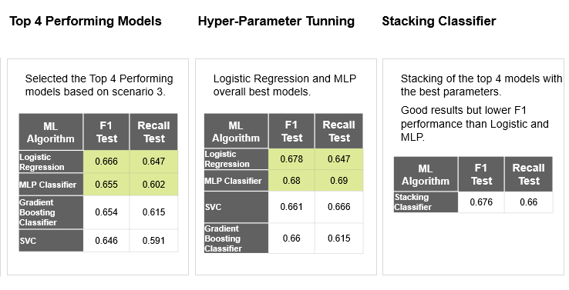
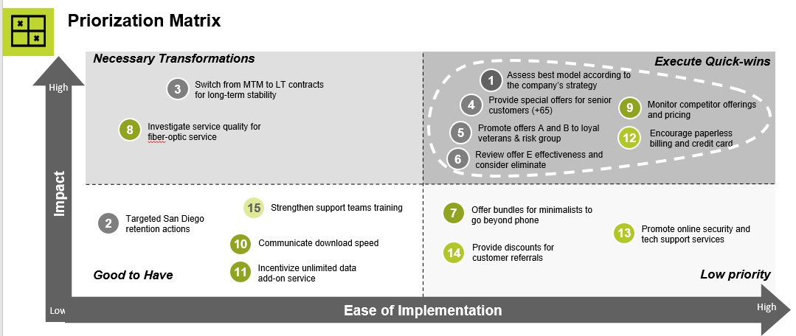
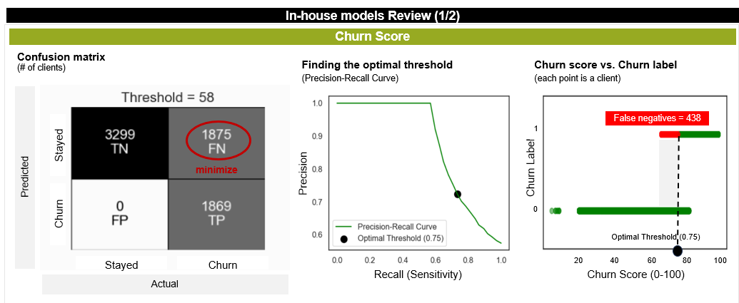
Introduction
Methodology
Findings
Recommendations
Our approach entailed four major stages
Methodology - overview
Plan and kick-off
Descriptive analysis
Predictive analysis
Define key actions
Objective
Define project scope and kick-off
Explore data to better understand customers and churn
Developed tailored, and fine-tuned predictive algorithms for churning
Identify opportunities for improvement
Key Activities
Project scope definition
Workspace set-up
Market assessment
Business understanding
Exploratory data analysis
Preprocessing
Feature engineering
Clustering analysis
Feature selection
Baseline models
Best performing models
Hyper-parameter tunning
Identify key actions
Prioritize based on impact and ease of implementation
Present recommendations
Output Preview
Notes:
Our approach entailed 4 major stages.
The 1st one was the planning and kick-off included the project scope and understanding of your business.
Then, we had two major stages which is where we’ll delve into when presenting findings.
Descriptive analysis where we have done exploration and clustering.
Then, predictive analysis, where we have tested different predictive algorithms for churning.
And in the end, defining the key actions
2min30seg

Slide 9

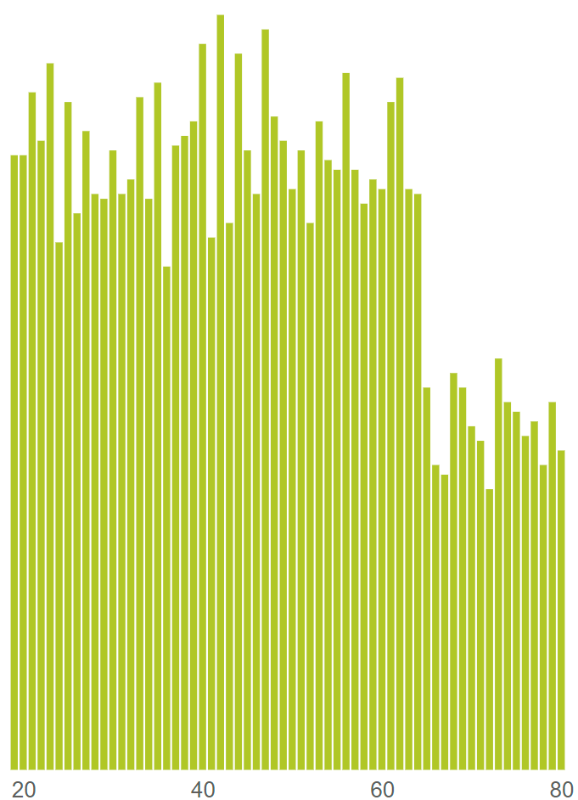
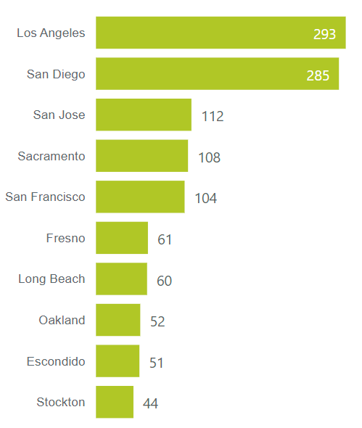

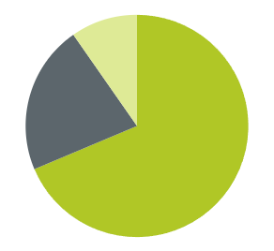
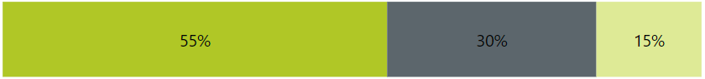

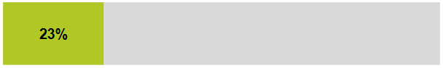



Introduction
Methodology
Findings
Recommendations
Most customers have no dependents, live in LA and San Diego, are internet users (79%) favouring Fiber with unlimited data and multiple phone lines
* Detailed analysis on Appendix 2
Customers’ snapshot
% of total customers
Demographic
Geographic
Services
Gender
Age distribution
# of Clients per city
Main Services
Out of 79% Clients with Internet and 91% with Phone…
50.5%
Only Internet
Internet type
Fiber
DSL
Cable
49.5%
Only Phone
22%
55%
30%
69%
Is Married?
Top 2 add-ons
Phone & Internet
86% Unlimited Data
48%
47% Multiple Phone Lines
Has Dependents?
~47 Years old
>50% of clients prefer paperless billing, bank withdrawal and month to month contracts.
Streaming
Movies
23%
50%
TV
49%
Music
20
60
80
45%
Notes:
So, without further do, let's navigate through the findings starting out with a customers’ snapshot where we can see….
… that most customers have no dependents, are 47 years old on average, they live in LA and San Diego, are internet users favouring Fiber and they have unlimited data and multiple phone lines.
Half of them use streaming services from 3rd parties and the majority prefers paperless billing, bank withdrawals and month to month contracts.

Slide 10


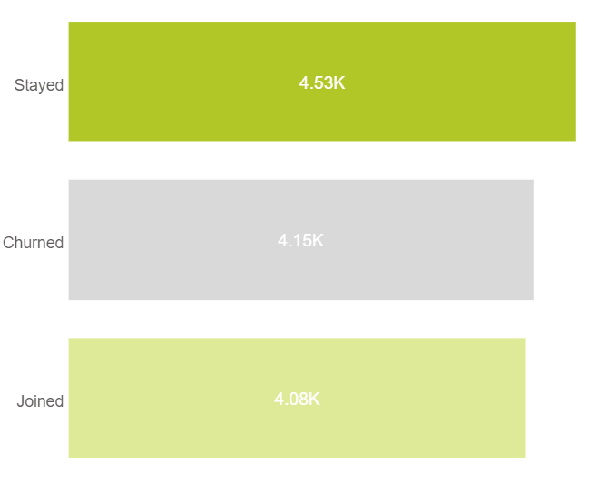

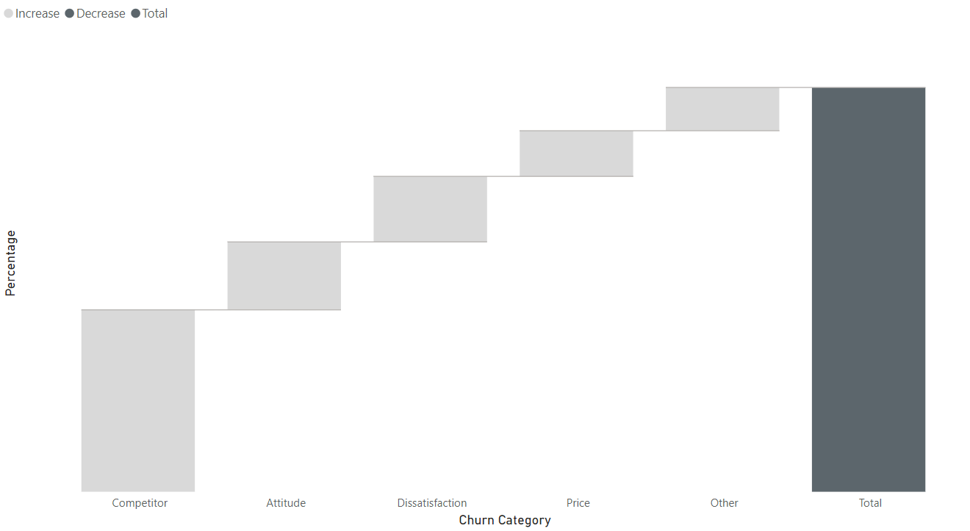
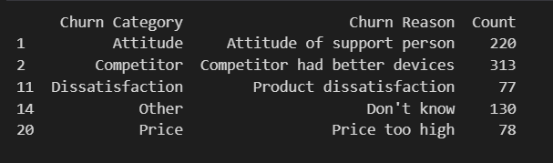
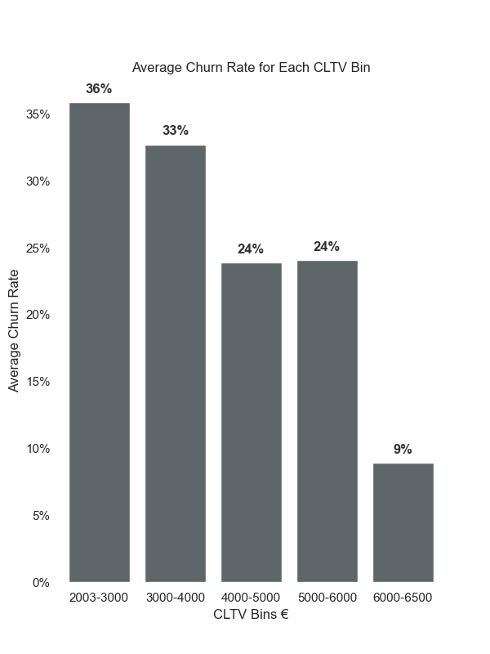
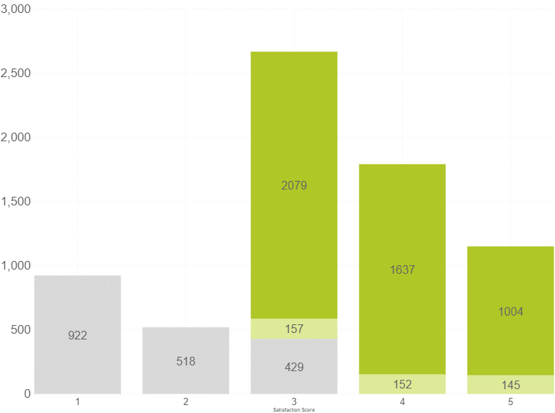
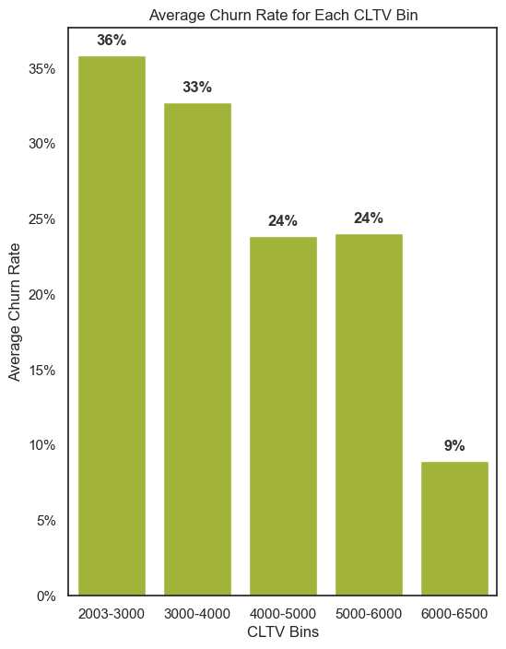
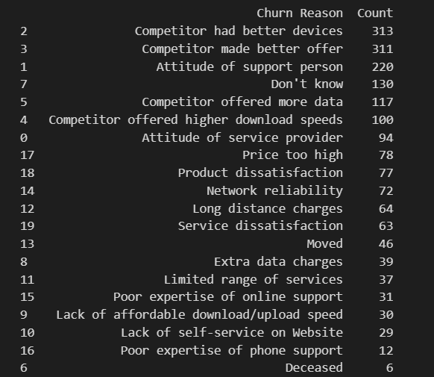


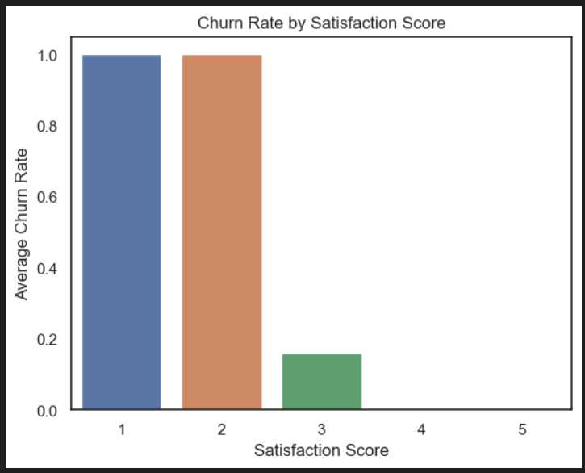
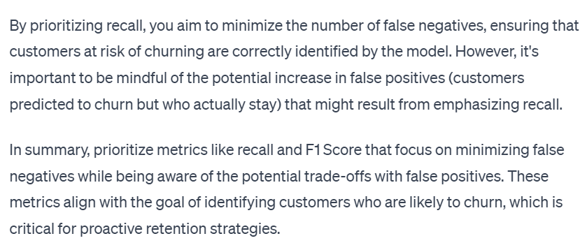
Introduction
Methodology
Findings
Recommendations
The sample of churners (27%) tell us that competitor is the main reason for churn and churners have satisfaction scores inferior or equal to 3 (out of 5)
Customers’ status Review
Are all churners voluntary?
(Average amount )
Churners’ snapshot
In-house models Review (1/2)
4.53 k
Clients
Total Churners
Churners Breakdown by Type (% of total churners)
Satisfaction Score
Customer Lifetime Value
4.15 k
7043
(# of clients)
1 – Low satisfaction
5 – High satisfaction
11%
Stayed
Churned
Joined
4.08 k
100%
36%
Other
12%
#7 Too high
33%
CLTV further analysis
For each bin of CLTV compute churn rate to monitor if there are high churn rates for high CLTV customers.
Price
16%
#8 Product
Churners
Dissatisfaction
17%
24%
24%
#3 Attitude of support person
2079
27%
Attitude
1637
1869
1004
44%
922
157
#1 Better devices
#2 Better offer
#4 More data
#5 Download speed
518
429
1
2
3
152
145
9%
4
5
Expensive to get Satisfaction Score
Competitor
Notes:
About churners:
This portion includes 1800 customers and here there is the breakdown of churning reasons.
The top reasons are related with competitor which represents 44% - about competitors having better devices, better offers, more data and download speed.
Then, attitude of support teams, the product dissatisfaction and the price being too high are also key reasons.
We have done a review of your in-house models for satisfaction score, CLTV and churn.
You have had significant costs to get the Satisfaction Score which including reaching out to your customers to conclude about their satisfactions. It’s quite correlated with churn, because those who are less satisfied churn which is quite expectable.
Then, as for CLTV, XXXXXXXX. High valuable customers have lower churn rates.
---4min

Slide 11
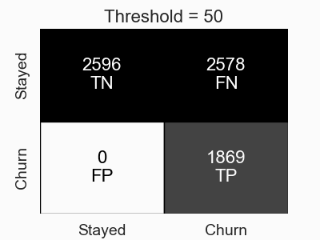
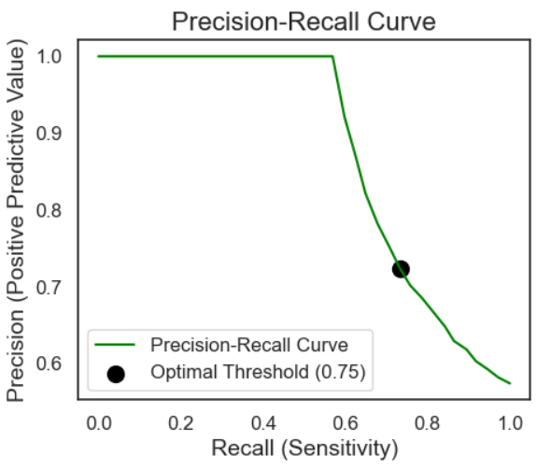
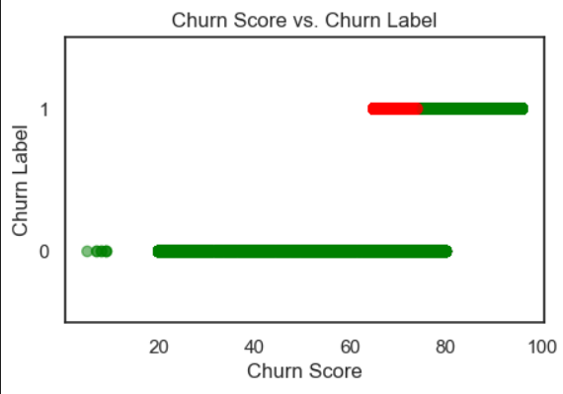
Introduction
Methodology
Findings
Recommendations
The in-house model fails to identify 23% (438) of all churners, highlighting the necessity to develop a more effective predictive model
Customers’ status Review
Given that it is more critical to identify customers who are likely to churn (minimizing false negatives), you should prioritize metrics that focus on recall or sensitivity. Precision-recall course
In-house models Review (1/2)
Churn Score
Confusion matrix
(# of clients)
Finding the optimal threshold
(Precision-Recall Curve)
Churn score vs. Churn label
(each point is a client)
False negatives = 438
1
Optimal threshold:
it's the point where the model is good at identifying positive instances (high recall) and is also accurate when it predicts positive instances (high precision).
This is the point where the trade-off between precision and recall is considered balanced.
Stayed
Predicted
minimize
Precision
Churn Label
Churn
0
Churn
0
Optimal Threshold (0.75)
20
40
60
80
100
Actual
Recall (Sensitivity)
Churn Score (0-100)
Stayed
Notes:
Your strategy has been to target and retain customers identified as likely to churn and you need a balanced approach. One that considers both:
Recall to not missing any customers who might churn (minimizing false negatives)
Precision to ensure you’re not spending resources on customers who weren’t going to churn (keeping in mind the trade-off with false positives)
So, we considered your churn score and found the optimal threshold through the precision-recall curve and conclude that your current model fails to identify 23% of all churners highlighting the opportunity to improve the predictive model.
------------------------------------------------------------------------------------------------------------------------
True Positives (TP): The number of samples correctly predicted as positive (Churn) by the model.
True Negatives (TN): The number of samples correctly predicted as negative (Stayed) by the model.
False Positives (FP): The number of samples incorrectly predicted as positive (Churn) when the actual class is negative (Stayed).
False Negatives (FN): The number of samples incorrectly predicted as negative (Stayed) when the actual class is positive (Churn).

Slide 12
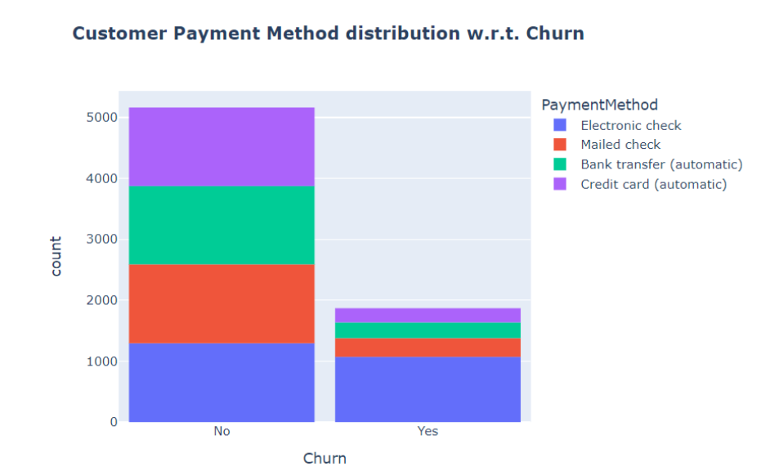
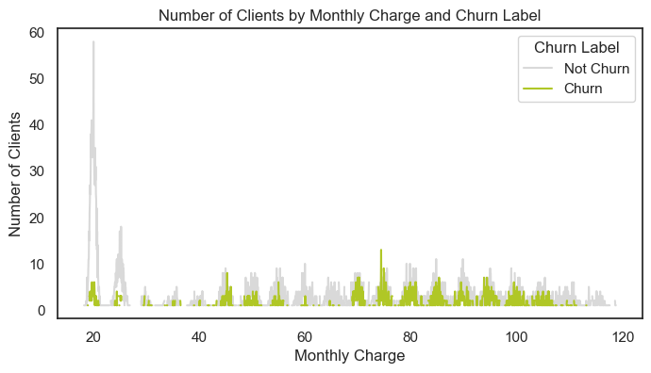
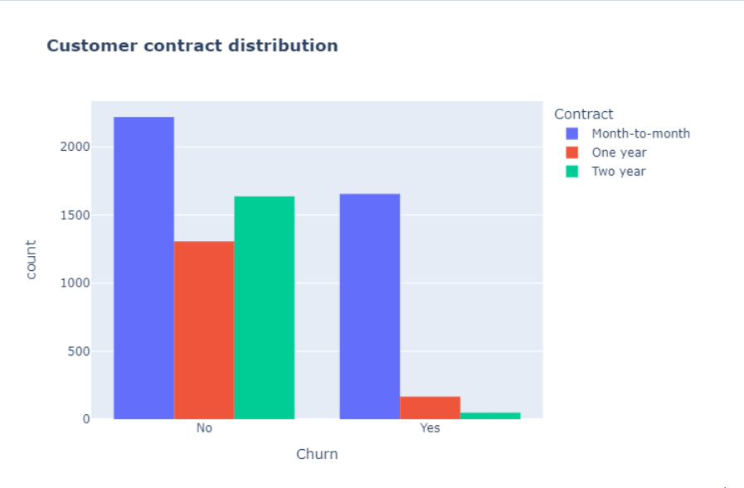
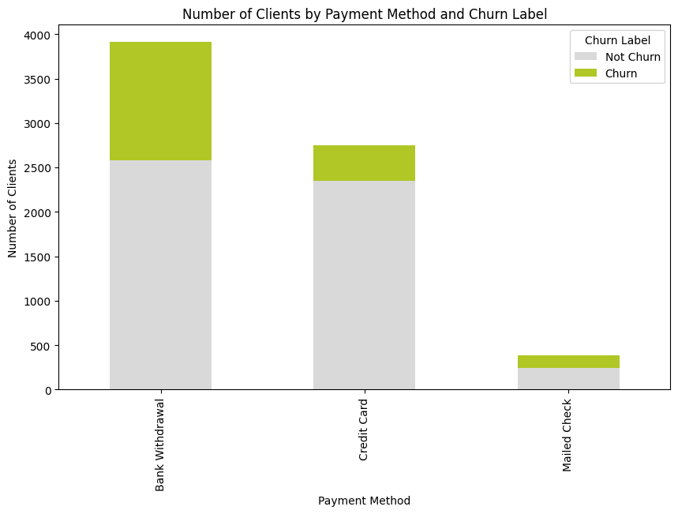
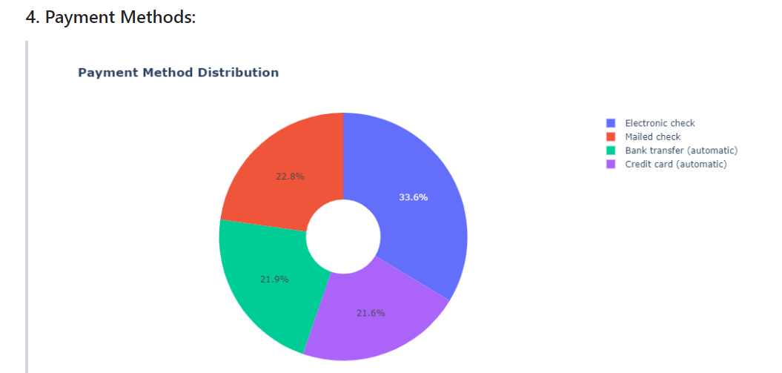
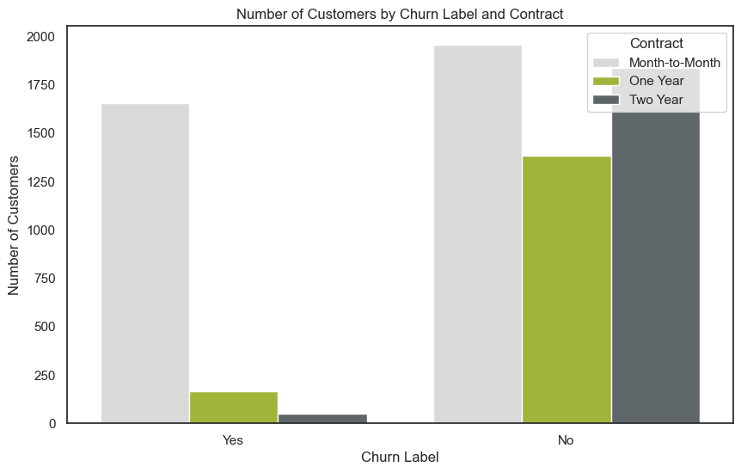
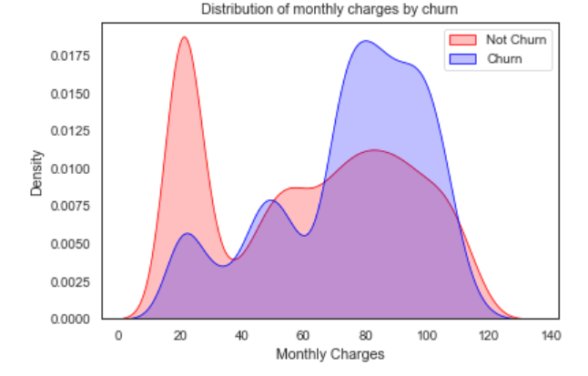
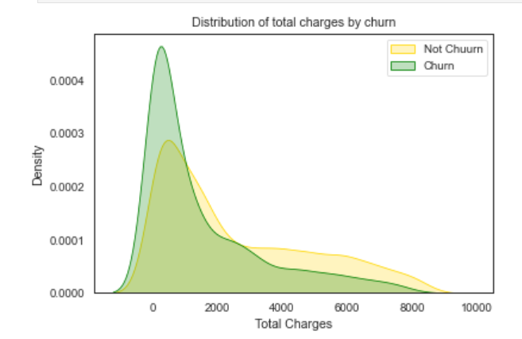
Introduction
Methodology
Findings
Recommendations
Keeping all constant, getting offer E or being from San Diego increases churn. Not having internet, getting offer A or having dependents reduces churn
27% Overall Churn
Churn Drivers
-
Negative Impact
+
Positive Impact
Churn Rate
Churn Rate ∆
Churn Rate
Churn Rate ∆
City: San Diego
64%
+ 37pp
Internet Service: No
7%
- 20pp
Offer: Offer E
53%
+ 26pp
Offer: Offer A
7%
- 20pp
Contract: Month-to-Month
45%
+ 18pp
Dependents: Yes
7%
- 20pp
Age: 65+
42%
+ 15pp
Offer: Offer B
12%
- 15pp
Internet Type: Fiber Optic
41%
+ 14pp
Online Security: Yes
Premium Tech Support: Yes
15%
- 12pp
Payment Type: Mailed Check
37%
+ 10pp
Payment Type: Credit Card
15%
+12pp
Customers with higher monthly charges are more likely to churn?
Notes:
Keeping all constant we have identified that being from san diego, offer E and month to month contracts increase churn quite a lot.
However, there are also positive drivers that might decrease churn. So there are some things that call our action for further analysis.

Slide 13






Introduction
Methodology
Findings
Recommendations
Customers were segmented into “Risk Group” as having 50% churn rate,
“Loyal Veterans” and “Minimalists” to better draw targeted actions for each group
Customer segments
1
2
3
Risk Group
3069 customers
50% churn rate
Loyal Veterans
2401 customers
8% churn rate
Minimalists
1573 customers
8% churn rate
Brief Methodology Note
A segmentation algorithm was applied to group customers with similar behaviour and track movement.
Unsupervised algorithm in play:
K-Means
Selected features to segment customers based on churn drivers to identify a risk group.
Lowest tenure
Short-term contracts
Highest tenure
Long-term contracts
Balanced
100% Internet users
Fiber Optic
100% Internet users
Fiber Optic
No Internet, only Phone users
Lowest CLTV
Highest CLTV
Medium CLTV
Offer E
Offer A & B
Balanced
37% married
63% married
Balanced
Notes:
Customers were segmented into 3 clusters using K-Means algorithm and selected features that are churn drivers with the goal of identifying this Risk Group.
As you can see, this group has 50% churn rate and includes 3000 customers. This group have the lowest tenure, use short-term contracts, are internet users with fiber optic and use offer E. So mostly negative churn drivers.
Then we have two other clusters which are the Loyal Veterans – our most valuable customers and that stay with us for longer – and the Minimalists – which only Phone services.
Our goal should be to move the customers in the Risk Group to the Loyal Veterans (decrease their risk of churning) and…
…move the Minimalists to the Loyal Veterans to capture more value from them.
---6min

Slide 14
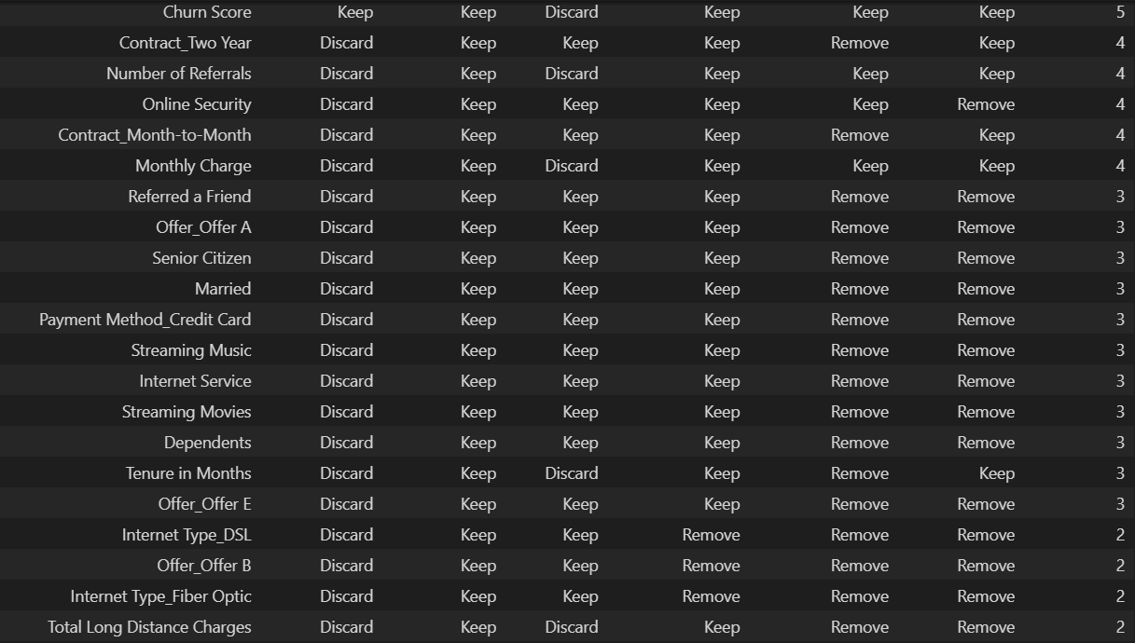


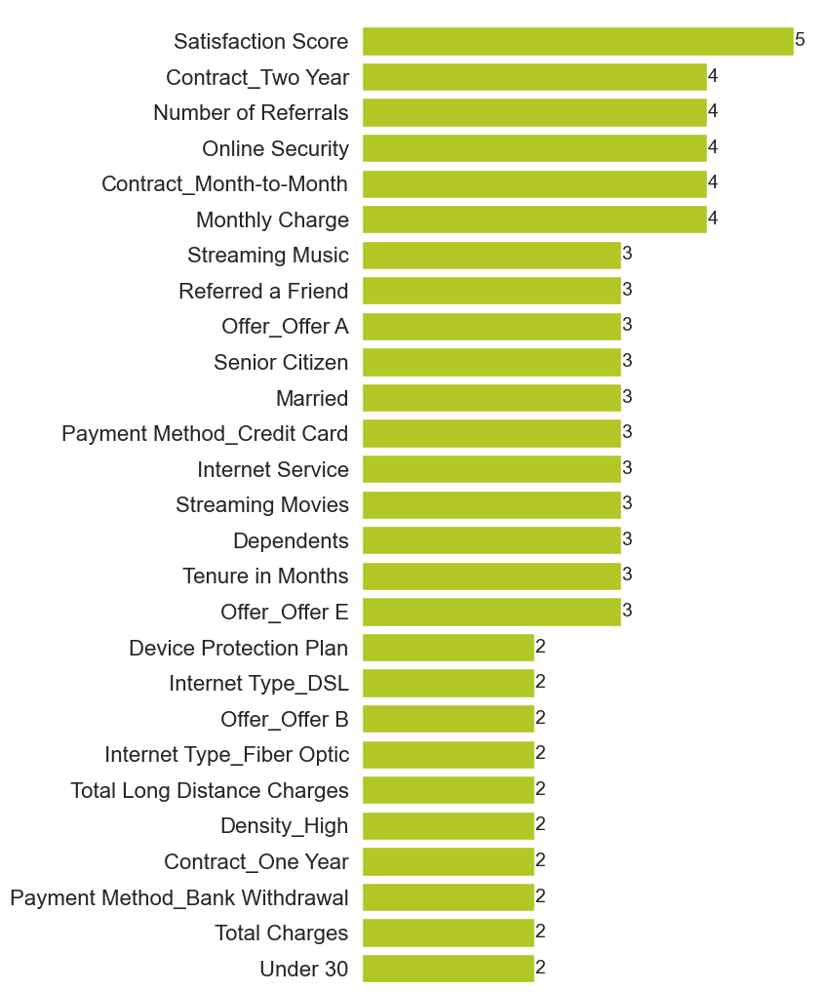
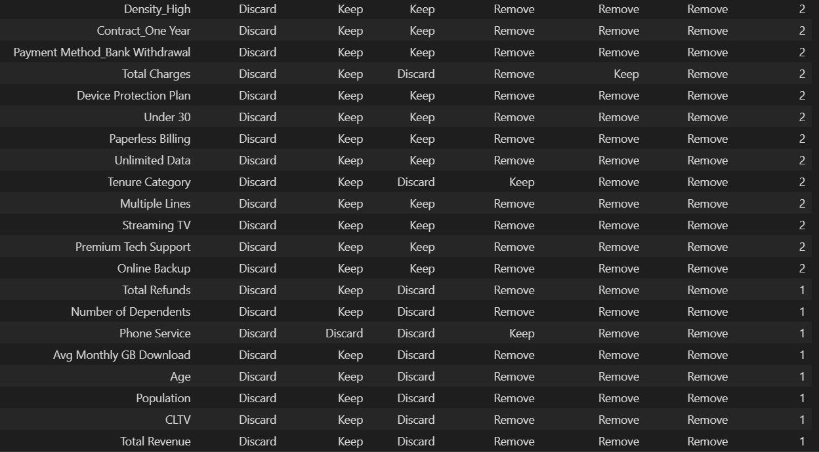
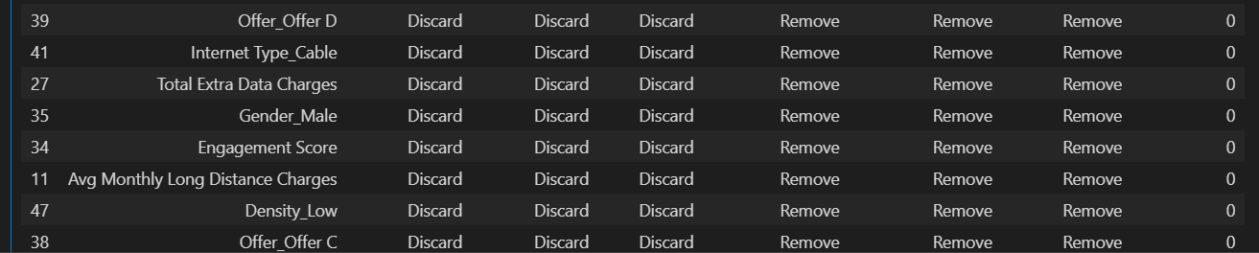
Satisfaction score
Introduction
Methodology
Findings
Recommendations
Feature selection methods and insights from exploratory analysis synergize to unveil optimal feature combinations to predict customer churn…
* Detailed analysis on Appendix 3
Features selection
Long list
First selection
Results
Second selection
Selected short list
51 features
Statistical / correlation tests:
Kendal
ANOVA
CHI2
Feature Selection Methods:
Wrapper RFECV
Embedded Lasso
ML algorithms:
Embedded RF
28 features
Married
Dependents
City
Referred a Friend
Tenure Category
Online Security
Contract MTM
Premium Tech Sup.
Streaming TV
Total Charges
Satisfaction Score
Number of Referrals
Contract Two Years
…
Monthly Charge
Unlimited Data
Streaming Music
Streaming Movies
Paperless Billing
Total Refunds
Satisfaction Score
CLTV
Internet Service
Senior Citizen
Top features score¹
Multiple scenarios testing across a baseline set of models² with default parameters.
Each scenario is a combination of different features.
Top 3 scenarios:
Online Security
Contract MTM
Payment Method CC
Senior Citizen
Premium Tech Sup
Offer E
Offer A
Referred a Friend
Dependents
Internet Type_F. Optic
Internet Service
Unlimited Data
Paperless Billing
+
Satisfaction Score
 | Avg. Test F1 Score
Scenario 1 | 0.631
Scenario 2 | 0.642
Scenario 3 | 0.652
Criteria: Excluded features with a score below 2
Excluded from all methods
Churn drivers:
City: San Diego
Offer: Offer E
Contract: Month-to-Month
Age: 65+
Internet Type: Fiber Optic
Payment Type: Mailed Check
Internet Service: No
Offer: Offer A
Dependents: Yes
Offer: Offer B
Online Security: Yes
Premium Tech Support: Yes
Payment Type: Credit Card
Notes:
As for the predictive stage. We have applied feature selection methods to unveil the optimal feature combination to predict churn.
After applying statistical and correlation tests, feature selection methods and ML algorithms we have ranked features and got to a top 28.
Then we have tested multiple combinations of features across a baseline of models with default parameters and found the TOP scenario with highest F1 score.
This got us to a short list of features.

Slide 15

Introduction
Methodology
Findings
Recommendations
After feature selection, performance metrics were tracked for models after hyper-parameter tunning and stacking resulting in the final selection
Predictive Modelling Methodology
Top 4 Performing Models
Hyper-Parameter Tunning
Stacking Classifier
Final Model selected for further analysis
Selected the Top 4 Performing models based on scenario 3.
Logistic Regression and MLP overall best models.
Stacking of the top 4 models with the best parameters.
Good results but lower F1 performance than Logistic and MLP.
Logistic Regression selected for further comparison with in-house model as having interpretabilities capability.
ML Algorithm | F1 Test | Recall Test
Logistic Regression | 0.666 | 0.647
MLP Classifier | 0.655 | 0.602
Gradient Boosting Classifier | 0.654 | 0.615
SVC | 0.646 | 0.591
ML Algorithm | F1 Test | Recall Test
Logistic Regression | 0.678 | 0.647
MLP Classifier | 0.68 | 0.69
SVC | 0.661 | 0.666
Gradient Boosting Classifier | 0.66 | 0.615
ML Algorithm | F1 Test | Recall Test
Stacking Classifier | 0.676 | 0.66
Notes:
Moving on, after selecting the features, we have here the top 4 performing models, we have done hyper-parameter tunning, stacking classifier and our conclusion is that Logistic Regression and MLP Classifier present the best performance.
For its explanability / interpretability capabilities we have decided to move on with Logistic Regression to compare with the in-house model.
---7min

Slide 16


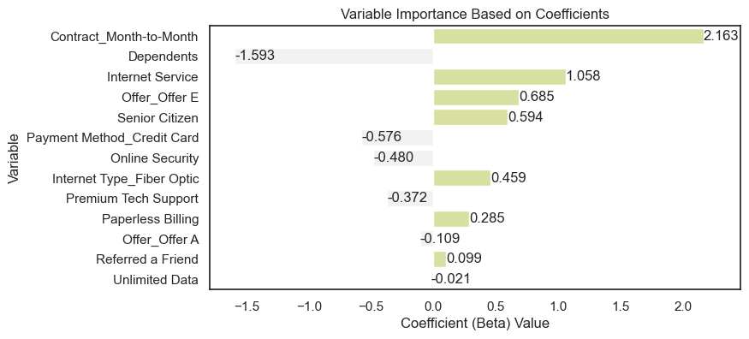

Introduction
Methodology
Findings
Recommendations
Alternatives to the in-house model are proposed, including one that provides better performance but considerable costs to obtain satisfaction score
Predictive Models Comparison
1
In-house Model (IBM)
2
Logistic Regression #1
3
Logistic Regression #2
Description | In-house model based on IBM Tool assuming an optimal threshold of 75 Churn Score. | Logistic Regression with Satisfaction Score. | Logistic Regression without Satisfaction Score.
Performance Metrics | F1 Score 0.752 | F1 Score 0.921 | F1 Score 0.678
Pros | Already Implemented Better Performance than LR | Best Performing Model Low computation cost | High interpretability Low computation cost
Cons | No interpretability with current information | High costs of maintaining Satisfaction Score | Lower Performance than IBM Churn Score
Features relevance for predicting churn – churn drivers!
Features Importance - Discuss the key features that the model identified as significant for predicting churn. Explain how these features contribute to the prediction. Use visuals, such as feature importance plots, to make it more accessible.
0
932
103
0
1017
18
0
924
111
Actual
Actual
Actual
132
242
1
86
288
1
41
333
1
0
1
0
1
0
1
Predicted
Predicted
Predicted
Illustrative
!
Notes:
So when comparing predictive models, your in-house model provides very good results (F1 Score 0.752). If we include satisfaction score in our analysis it presents a higher score than yours however this has the disadvantage of high costs of maintaining satisfactions core and not guaranteed to obtain for all new customers.
Due to its ability to provide clear and understandable explanations explain ability and low computational cost, we used the 3rd model – Logistic Regression without satisfaction score - to identify opportunities and draw recommendations.
XXXX Qual é a nossa conclusão aqui??? XXXXXXXXXX --- n vale a pena falar no score do #3 diria
-8min

Slide 17






Win-back activities = reconnections
Introduction
Methodology
Findings
Recommendations
Based on our findings, we provide recommendations focusing on anti-churn activities with proactive prevention grouped in 5 key areas of improvement
Dúvidas:
Customers who have dependents ???
Prioritize investments in network infrastructure to enhance reliability and performance – dizemos algo sobre isto?
Interpretation of customer referrals?
Recommendations
Areas of improvement
Initiatives
Rationale
Impact
Churn Identification
1 | Assess best model according to the company’s strategy | Different models were obtained whose adoption depends on strategy
2 | Targeted San Diego retention actions | San Diego is a negative churn driver; address city-specific concerns
3 | Switch from MTM to LT contracts for long-term stability | Risk group has short-term contracts, a high-impact churn factor
4 | Provide special offers for senior customers (+65) | Senior citizens is a negative churn driver
5 | Promote offers A and B to loyal veterans & risk group | Leverage offers for risk group and loyal veterans to boost CLTV
6 | Review offer E effectiveness and consider eliminate | Significant negative churn driver in the predictive model
7 | Offer bundles for minimalists to go beyond phone | Increase revenue by shifting minimalists to loyal veterans
8 | Investigate service quality for fiber-optic service | Fiber-optic is a negative churn driver in the predictive model
9 | Monitor competitor offerings and pricing | Competitor-related churn reasons are the most common
10 | Communicate download speed | Download speed is a common churn reason
11 | Incentivize unlimited data add-on service | Positive churn drivers associated with reduced churn
12 | Encourage paperless billing and credit card | Positive churn drivers associated with reduced churn
13 | Promote online security and tech support services | Positive churn drivers associated with reduced churn
14 | Provide discounts for customer referrals | Referrals contribute to customer acquisition strategy
15 | Strengthen support teams training | Addressing complains of “attitude” and “poor expertise”
Proactive Retention Strategies
Portfolio Optimization
Senior Citizens
Internet Fiber Optic
Contract MTM
Offer E
San Diego
Targeted retention plans or promotions for this demographic.
Ensure clear information on services, benefits, and promotions for senior clients
Investigate service quality and satisfaction for fiber-optic users.
Strengthen customer support for fiber optic users. Quick issue resolution can positively impact customer satisfaction.
Promote longer-term contracts with incentives for customer commitment.
Encourage customers to opt for longer contracts with benefits such as discounts or additional services.
Assess the effectiveness of this offer and its impact on customer loyalty.
Adjust promotional strategies based on performance
Launch targeted retention campaigns in San Diego, addressing city-specific concerns and preferences to enhance customer loyalty.
Customer Experience
Support Team
Logistic regression identifies key factors and flags potential churners
High
Medium
Low
Notes:
So here are our final recommendations. We have 5 major areas of improvement:
-> Churn identification – where we recommend to assess best model according to the company’s strategy. The adoption of a predictive model depends on your goals and priorities. We recommend using ours for explanability and low computation cost as mentioned.
Then
A few proactive retention strategies
Porfolio optimization with relation to services and offers
Customer experience such as payment methods
Support team to give more training to your team because Attitude and poor expertise prevail as being major complains from customers
in which we explored opportunities to empower you with solutions that make a positive impact on your customer relationships and business outcomes.

Slide 18

Connect results – overlapping patterns in all analysis
Predictive features are associated with specific clusters?
Predictive insights for each cluster?
Implementation Plan - Outline the steps for implementing the predictive model. Discuss any necessary resources, timelines, or collaboration required. Address potential challenges and mitigation strategies. Flag customers and make concrete actions based on that!
Next Steps and Collaboration - Discuss potential next steps, including collaboration for further refinement or additional data. Highlight the importance of ongoing monitoring and model maintenance.
Introduction
Methodology
Findings
Recommendations
We recommend to execute the quick-wins, followed by the necessary transformations to generate the highest impact
Priorization Matrix
Low
Necessary Transformations
Execute Quick-wins
Switch from MTM to LT contracts for long-term stability
1
Assess best model according to the company’s strategy
3
4
Provide special offers for senior customers (+65)
9
Monitor competitor offerings and pricing
8
Investigate service quality for fiber-optic service
5
Promote offers A and B to loyal veterans & risk group
12
Encourage paperless billing and credit card
Impact
6
Review offer E effectiveness and consider eliminate
15
Strengthen support teams training
7
Offer bundles for minimalists to go beyond phone
2
Targeted San Diego retention actions
Ease of Implementation
13
Promote online security and tech support services
10
Communicate download speed
14
Provide discounts for customer referrals
11
Incentivize unlimited data add-on service
Low priority
Good to Have
High
High
Notes:
As these are 15 initiatives and each one has different level of impact and easiness of implementation, we have grouped them according to priority.
We recommend you execute the quick-wins which are 6 key initiatives that have high impact on decreasing churn and easier to implement.
Then the necessary transformations are also key but harder to implement.
…. More detail on top initiatives if we have time….

Slide 19
Thank You
Any Questions?

Slide 20
Appendix
01 Team presentation
02 Customer detailed analysis
03 Performance metrics

Slide 21



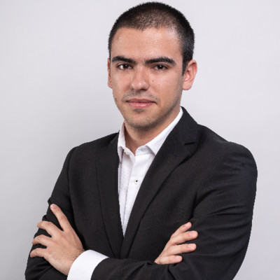
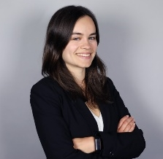
Our project team presents a diverse skill set and gathers technical and business capabilities as well as track record in data science projects
01 Team presentation
Our project team presents relevant capabilities…
… which translate into competitive advantages
Multisectoral Expertise & Fresh Innovation
An outside perspective from diverse industries for inside breakthroughs
Diogo Gaspar
Financial Analysis
IT Software
Jorge Milhomem
Tech & Innovation
Financial Services
Tiago Ferreira
Business Analysis
Consumer electronics
Sara Sustelo Santos
Strategy Advisory
Consulting
Proven Team Synergy & Track Record
Together, we’ve triumphed before; let’s chart the next success story
Management degree and MBA
Financial control and analysis, Investment, Auditing and Consulting
Mechanical Engineering
Mathematics, Engineering, Physics, IT Product Management
Economics degree
Consumer electronics, IT, Mobile Communications and device solutions
Master in Finance & Economics degree
Strategy, Corporate Finance, Venture Capital (FinTech), BI, IoT, Management
Data-Driven Decision Making & Cutting-Edge Technology
Harnessing the power of data with tomorrow’s tech, today

Slide 22
02 Customer detailed analysis
Customers are 47 years on average, well-distributed in terms of gender and marriage, are predominantly without dependents. LA & San Diego are top cities
Client understanding
% of total
customers
Gender
Age distribution
% of total customers
Clients per city
In numbers
Demographic
Geographic
50.5%
49.5%
Services
Is Married?
~47 Years old
20%
48%
Preferences
Has Dependents?
Status
23%

Slide 23



02 Customer detailed analysis
79% of customers are Internet users: mainly on Fiber type (55%) and DSL (30%) with unlimited data as an add-on service (86%)
Client understanding
Main Services
% of total customers
Out of 79% Clients with Internet…
% of internet users
Demographic
Internet type
Fiber
DSL
Cable
Only Internet
Geographic
55%
30%
15%
10%
Internet Add-ons
Yes
No
Services
Unlimited Data
Only Phone
22%
69%
Online Backup
Preferences
Device Protection Plan
Phone & Internet
Premium Tech Support
Status
Online Security

Slide 24

02 Customer detailed analysis
Half of the internet users utilize streaming services from 3rd-party providers. 91% of customers use Phone service and 47% of those use multiple lines
Client understanding
Main Services
% of total customers
Out of 79% Clients with Internet…
% of internet users
Demographic
Streaming
Movies
Yes
No
Only Internet
Geographic
10%
TV
Services
Only Phone
22%
Music
69%
Preferences
Out of 91% Clients with Phone…
% of phone users
Status
Phone & Internet
Phone Add-on
Multiple
Lines

Slide 25

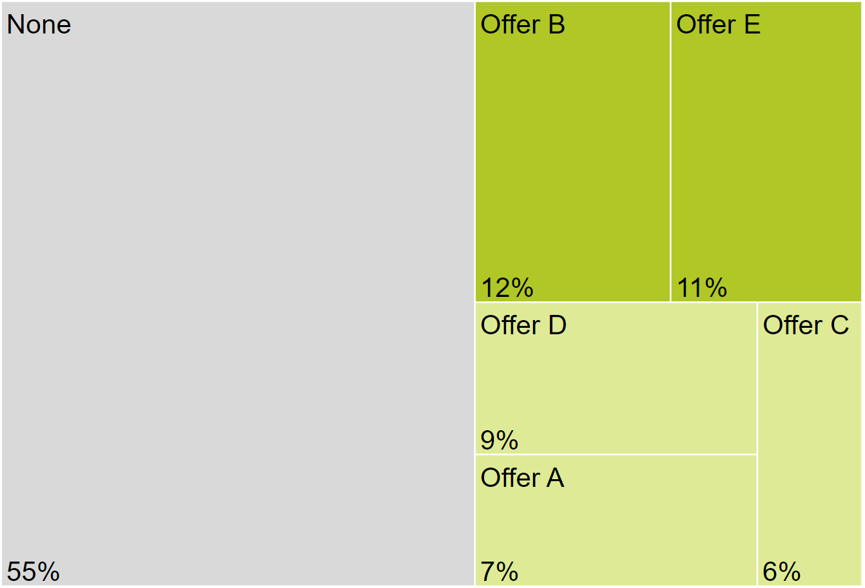


02 Customer detailed analysis
More than half of customers prefer paperless billing, bank withdrawal and month to month contract types. The majority accepted no offers
Client understanding
Payment preferences
% of total customers
Marketing Offers
% of total customers
Demographic
Paperless Billing
Yes
No
Geographic
59%
Services
Payment Method
Bank Withdrawal
Credit Card
Mailed Check
56%
39%
5%
Preferences
39%
Contract Type
Month to month
1 Year
2 Years
Status
51%
22%
27%

Slide 26
02 Customer detailed analysis
Over half of customers satisfaction rate between 3 and 4, with an average CLTV of $4.53 k for retained customers
Client understanding
Stayed
Churned
Joined
Satisfaction Score
In number of clients
1 – Low satisfaction
5 – High satisfaction
Customer Lifetime Value (CLTV)
Average amount
Demographic
Geographic
4.53 k
Services
4.15 k
Preferences
4.08 k
Status
1
2
3
4
5

Slide 27
02 Customer detailed analysis
The sample of churners (27%) is categorized depending on the churn type, with competitor being the main reason for churn
Client understanding
Demographic
Churners Breakdown by Type
% of total churners
Clients and Churners
In numbers
11%
7043
100%
Geographic
12%
16%
27%
Services
17%
1869
Preferences
44%
More data
Better devices
Better offer
Higher download speed
Status
Competitor
Attitude
Dissatisfaction
Price
Other
Total Churners
Total Churners
Clients

Slide 28

03 Performance metrics
Scenario 1 Tested Models Performance Results
Scenario 1 Without Satisfaction Score
Model | Accuracy Training | Accuracy Validation | Accuracy Test | F1 Training | F1 Validation | F1 Test | Recall Training | Recall Validation | Recall Test
GaussianNB | 0.753 | 0.751 | 0.768 | 0.639 | 0.636 | 0.652 | 0.822 | 0.82 | 0.818
GradientBoostingClassifier | 0.826 | 0.812 | 0.816 | 0.654 | 0.622 | 0.638 | 0.618 | 0.583 | 0.61
MLPClassifier | 0.809 | 0.808 | 0.817 | 0.622 | 0.621 | 0.635 | 0.592 | 0.593 | 0.599
RandomForestClassifier | 0.818 | 0.814 | 0.816 | 0.626 | 0.618 | 0.622 | 0.575 | 0.567 | 0.57
SVC | 0.798 | 0.796 | 0.805 | 0.612 | 0.61 | 0.622 | 0.601 | 0.6 | 0.604
LogisticRegression | 0.802 | 0.802 | 0.811 | 0.605 | 0.605 | 0.618 | 0.572 | 0.572 | 0.575
DecisionTreeClassifier | 0.817 | 0.809 | 0.813 | 0.627 | 0.611 | 0.608 | 0.58 | 0.565 | 0.545
KNeighborsClassifier | 0.85 | 0.791 | 0.801 | 0.704 | 0.589 | 0.598 | 0.671 | 0.565 | 0.556
Scenario 1 With Satisfaction Score
Model | Accuracy Training | Accuracy Validation | Accuracy Test | F1 Training | F1 Validation | F1 Test | Recall Training | Recall Validation | Recall Test
GradientBoostingClassifier | 0.957 | 0.949 | 0.955 | 0.919 | 0.902 | 0.913 | 0.907 | 0.887 | 0.901
MLPClassifier | 0.95 | 0.95 | 0.953 | 0.905 | 0.904 | 0.912 | 0.897 | 0.894 | 0.909
SVC | 0.948 | 0.948 | 0.952 | 0.903 | 0.901 | 0.91 | 0.904 | 0.901 | 0.909
LogisticRegression | 0.946 | 0.945 | 0.952 | 0.894 | 0.893 | 0.906 | 0.869 | 0.864 | 0.88
KNeighborsClassifier | 0.962 | 0.942 | 0.943 | 0.927 | 0.888 | 0.891 | 0.909 | 0.871 | 0.877
GaussianNB | 0.934 | 0.933 | 0.938 | 0.878 | 0.877 | 0.887 | 0.897 | 0.896 | 0.912
DecisionTreeClassifier | 0.939 | 0.939 | 0.94 | 0.869 | 0.869 | 0.873 | 0.769 | 0.769 | 0.775
RandomForestClassifier | 0.942 | 0.94 | 0.94 | 0.877 | 0.873 | 0.873 | 0.784 | 0.779 | 0.775

Slide 29
03 Performance metrics
Scenario 2 Tested Models Performance Results
Scenario 2 Without Satisfaction Score
Model | Accuracy Training | Accuracy Validation | Accuracy Test | F1 Training | F1 Validation | F1 Test | Recall Training | Recall Validation | Recall Test
GradientBoostingClassifier | 0.829 | 0.813 | 0.827 | 0.668 | 0.637 | 0.658 | 0.645 | 0.616 | 0.628
MLPClassifier | 0.814 | 0.813 | 0.822 | 0.641 | 0.64 | 0.653 | 0.625 | 0.627 | 0.631
GaussianNB | 0.741 | 0.741 | 0.756 | 0.637 | 0.637 | 0.65 | 0.858 | 0.857 | 0.853
RandomForestClassifier | 0.819 | 0.813 | 0.821 | 0.63 | 0.618 | 0.638 | 0.581 | 0.571 | 0.594
SVC | 0.799 | 0.798 | 0.809 | 0.619 | 0.618 | 0.631 | 0.615 | 0.614 | 0.615
KNeighborsClassifier | 0.853 | 0.793 | 0.814 | 0.711 | 0.595 | 0.624 | 0.683 | 0.572 | 0.58
LogisticRegression | 0.804 | 0.802 | 0.81 | 0.615 | 0.613 | 0.618 | 0.59 | 0.589 | 0.58
DecisionTreeClassifier | 0.818 | 0.808 | 0.813 | 0.632 | 0.613 | 0.608 | 0.592 | 0.574 | 0.545
Scenario 2 With Satisfaction Score
Model | Accuracy Training | Accuracy Validation | Accuracy Test | F1 Training | F1 Validation | F1 Test | Recall Training | Recall Validation | Recall Test
GradientBoostingClassifier | 0.958 | 0.949 | 0.956 | 0.919 | 0.901 | 0.915 | 0.893 | 0.873 | 0.888
MLPClassifier | 0.948 | 0.946 | 0.952 | 0.898 | 0.893 | 0.908 | 0.862 | 0.853 | 0.885
KNeighborsClassifier | 0.962 | 0.942 | 0.95 | 0.927 | 0.888 | 0.903 | 0.907 | 0.868 | 0.888
LogisticRegression | 0.946 | 0.946 | 0.949 | 0.895 | 0.893 | 0.9 | 0.86 | 0.858 | 0.869
RandomForestClassifier | 0.945 | 0.943 | 0.948 | 0.884 | 0.88 | 0.892 | 0.798 | 0.793 | 0.81
SVC | 0.947 | 0.946 | 0.947 | 0.892 | 0.889 | 0.892 | 0.824 | 0.82 | 0.816
DecisionTreeClassifier | 0.939 | 0.939 | 0.94 | 0.869 | 0.869 | 0.873 | 0.769 | 0.769 | 0.775
GaussianNB | 0.865 | 0.866 | 0.874 | 0.783 | 0.784 | 0.796 | 0.919 | 0.919 | 0.928

Slide 30
03 Performance metrics
Scenario 3 Tested Models Performance Results
Scenario 3 Without Satisfaction Score
Model | Accuracy Training | Accuracy Validation | Accuracy Test | F1 Training | F1 Validation | F1 Test | Recall Training | Recall Validation | Recall Test
LogisticRegression | 0.821 | 0.819 | 0.828 | 0.652 | 0.648 | 0.666 | 0.634 | 0.632 | 0.647
MLPClassifier | 0.835 | 0.82 | 0.832 | 0.656 | 0.622 | 0.655 | 0.594 | 0.561 | 0.602
GradientBoostingClassifier | 0.829 | 0.822 | 0.828 | 0.655 | 0.64 | 0.654 | 0.612 | 0.598 | 0.615
RandomForestClassifier | 0.822 | 0.818 | 0.835 | 0.616 | 0.606 | 0.647 | 0.538 | 0.525 | 0.57
DecisionTreeClassifier | 0.814 | 0.81 | 0.815 | 0.631 | 0.623 | 0.646 | 0.602 | 0.592 | 0.634
SVC | 0.828 | 0.822 | 0.828 | 0.645 | 0.633 | 0.646 | 0.589 | 0.579 | 0.591
GaussianNB | 0.764 | 0.763 | 0.764 | 0.636 | 0.634 | 0.636 | 0.775 | 0.774 | 0.775
KNeighborsClassifier | 0.818 | 0.794 | 0.804 | 0.605 | 0.55 | 0.584 | 0.525 | 0.475 | 0.519
Scenario 3 ´With Satisfaction Score
Model | Accuracy Training | Accuracy Validation | Accuracy Test | F1 Training | F1 Validation | F1 Test | Recall Training | Recall Validation | Recall Test
GradientBoostingClassifier | 0.96 | 0.957 | 0.962 | 0.922 | 0.916 | 0.926 | 0.896 | 0.892 | 0.898
MLPClassifier | 0.963 | 0.956 | 0.96 | 0.928 | 0.914 | 0.923 | 0.902 | 0.89 | 0.901
SVC | 0.96 | 0.957 | 0.959 | 0.922 | 0.915 | 0.92 | 0.89 | 0.883 | 0.893
LogisticRegression | 0.954 | 0.953 | 0.957 | 0.911 | 0.908 | 0.916 | 0.882 | 0.882 | 0.885
DecisionTreeClassifier | 0.95 | 0.95 | 0.954 | 0.896 | 0.896 | 0.906 | 0.821 | 0.821 | 0.837
RandomForestClassifier | 0.942 | 0.942 | 0.943 | 0.877 | 0.877 | 0.879 | 0.783 | 0.782 | 0.783
KNeighborsClassifier | 0.931 | 0.907 | 0.916 | 0.862 | 0.811 | 0.829 | 0.811 | 0.751 | 0.77
GaussianNB | 0.886 | 0.883 | 0.884 | 0.8 | 0.796 | 0.797 | 0.863 | 0.859 | 0.856

